Slide 1

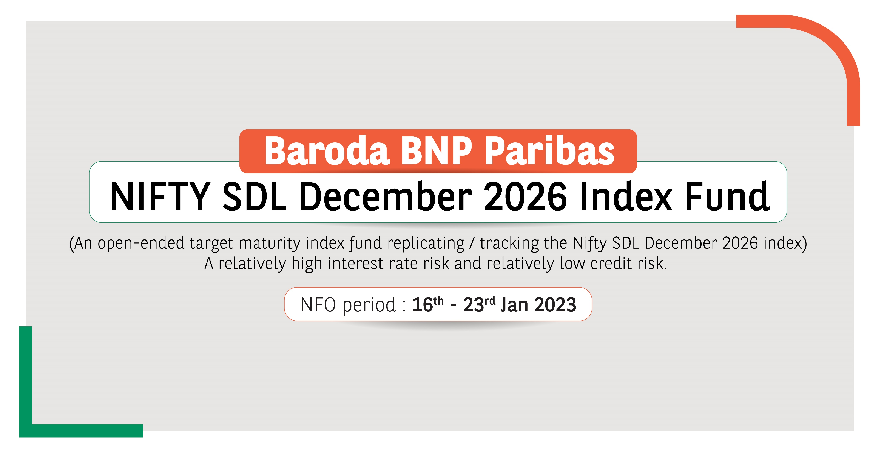

Slide 2









Target Maturity Funds
Target maturity funds are passive debt mutual fund schemes, tracking an underlying bond index.
Unlike other open ended mutual fund schemes, target maturity mutual funds have defined maturity dates.
On the maturity date, investors holding units of target maturity funds are expected to get the principal amount along with capital appreciation.
Some features
Transparency
No lock in period
Exposure to Sovereign and PSU papers
02

Slide 3

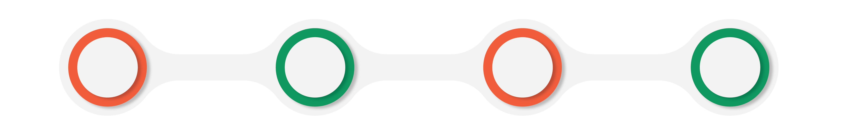


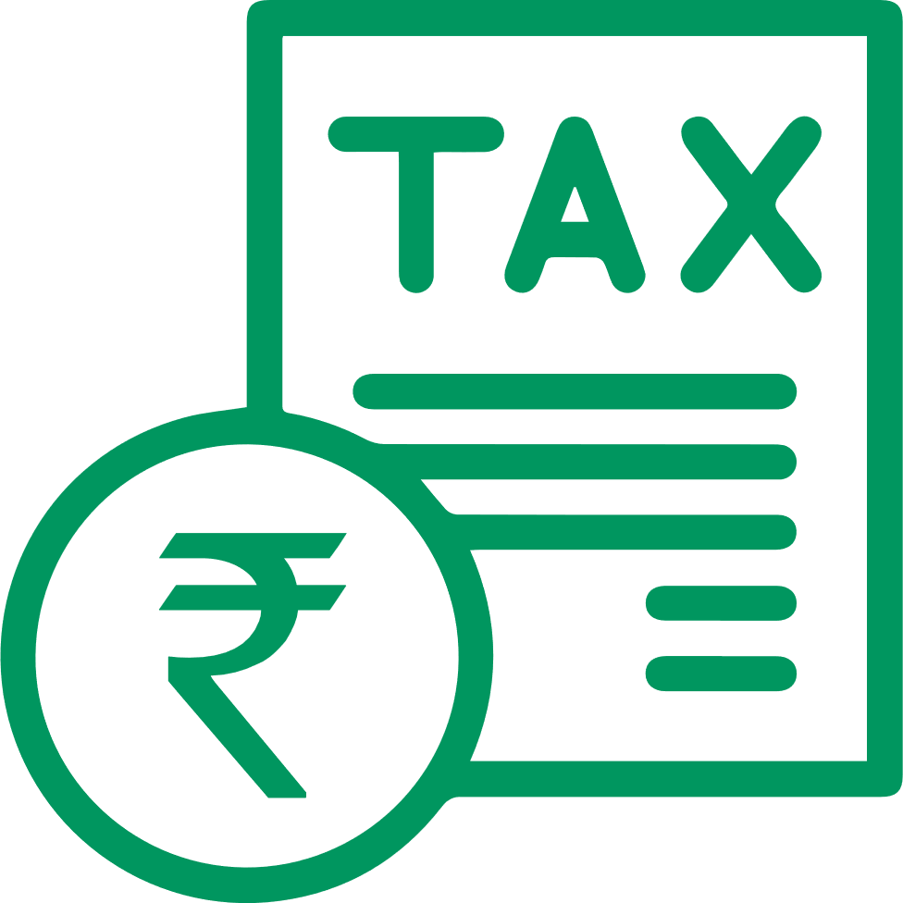

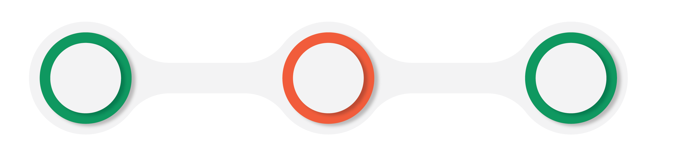
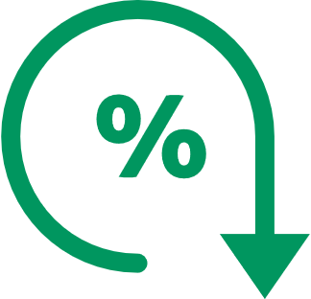

Benefits of Target Maturity Funds
Lower credit risk
Relatively predictable returns
Tax benefits
No lock in
These funds have lower credit risk vis-à-vis other asset classes
Returns would be similar to the net portoflio yield at the time of investment when the investments are held to maturity
Investors can avail of applicable indexation benefits for investments that are held for the long term
There‘s no lock in period. Investments can be redeemed any time, subject to exit loads
Transparency
Lower expense ratio
Exposure to sovereign
rated papers*
Target maturity funds replicate indexes - that disclose their constituents as well as methodology on a regular basis
Since these are passive funds, they tend to have a lower TER than comparable active funds
The fund tracks an index of SDLs – which are sovereign securities
*For Target Maturity Funds tracking indexes with G-Secs and SDLs
YTM generally does not include scheme expense, impact cost, etc. and returns can be different to that extent.
03

Slide 4
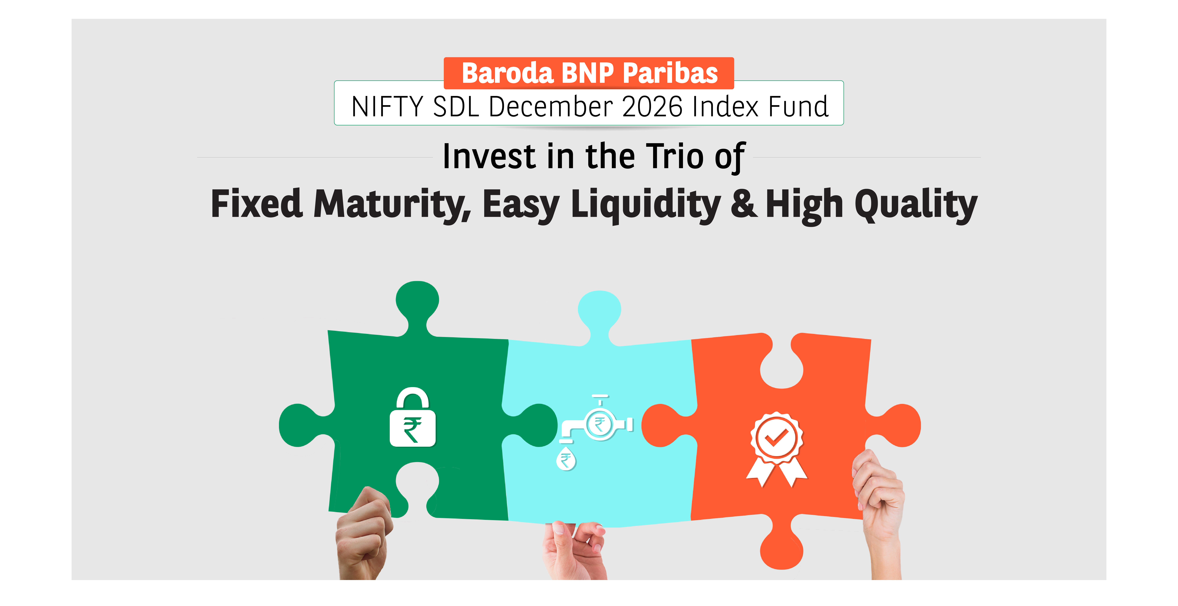
Introducing
04

Slide 5





Fund Strategy
Investment strategy
Benchmark Index
Methodology of the Index
The scheme is a target maturity index fund tracking the Nifty SDL December 2026 Index. The Scheme will be passively managed employing an investment strategy that tracks the performance of the underlying index*.
Nifty SDL Dec 2026 Index seeks to measure the performance of portfolio of 10 State Development Loans (SDLs) maturing during the six-month period ending December 31, 2026.
The index is computed using the total return methodology including price return and coupon return.
*Subject to tracking error
For further details on asset allocation, investment strategy and risk factors of the Scheme please refer to SID available on our website (www.barodabnpparibasmf.in). Investment strategy stated above may change from time to time and shall be in accordance with the investment objective and strategy stated in the SID of the scheme.
05

Slide 6





Index Methodology
Security selection
Weight assignment
Index rebalancing
For every selected state/UT, SDL with longest maturity maturing during the six-month period ending Dec 31, 2026, is selected to be part of the index.
Only one SDL per state/UT to be part of the index.
Each state/UT that is part of the index is given equal weight as on the base date of the index.
Subsequently, the security level weights may drift due to price movement and will not get reset.
On a semi-annual basis, index will be screened for compliance with the Norms for Debt Exchange Traded Funds (ETFs)/Index Funds.
For complete details, please refer to SID available on our website (www.barodabnpparibasmf.in).
06

Slide 7

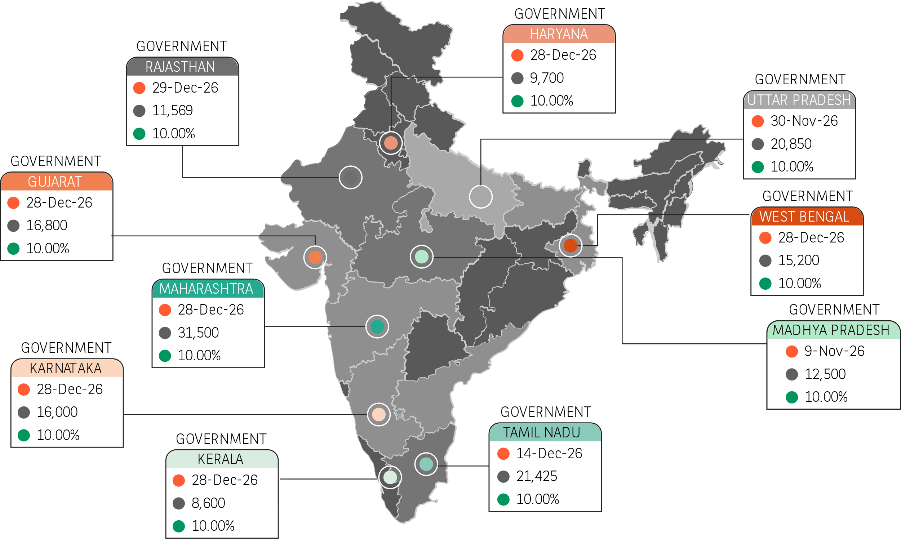
Index Constituents: Ample outstanding stock
Maturity Date
Issuer Outstanding Amount (Rs Crs)
Weight
Nifty SDL December 2026 Index
Total
Issuer Outstanding Amount (Rs Crs)
1,64,144
Weight
100%
YTM as on 30-12-2022(Semi-Annualised): 7.37%
YTM as on 30-12-2022 (Annualised) : 7.51%
Map is not to scale and it is only for illustration purpose.
The Scheme (s) are neither Capital Protected nor guaranteed Return Product and may or may not generate return in line with Index. Though the fund is supposed to replicate the index constituents, it is important to note that the same is subject to availability of SDLs comprising the index and provision of the Scheme Information Document (SID). YTM generally does not include scheme expense, impact cost, etc. and returns can be different to that extent. Actual returns can be different because of tracking error, tracking difference, expenses, etc.
07

Slide 8

STATE DEVELOPMENT LOANS (SDL)
08

Slide 9

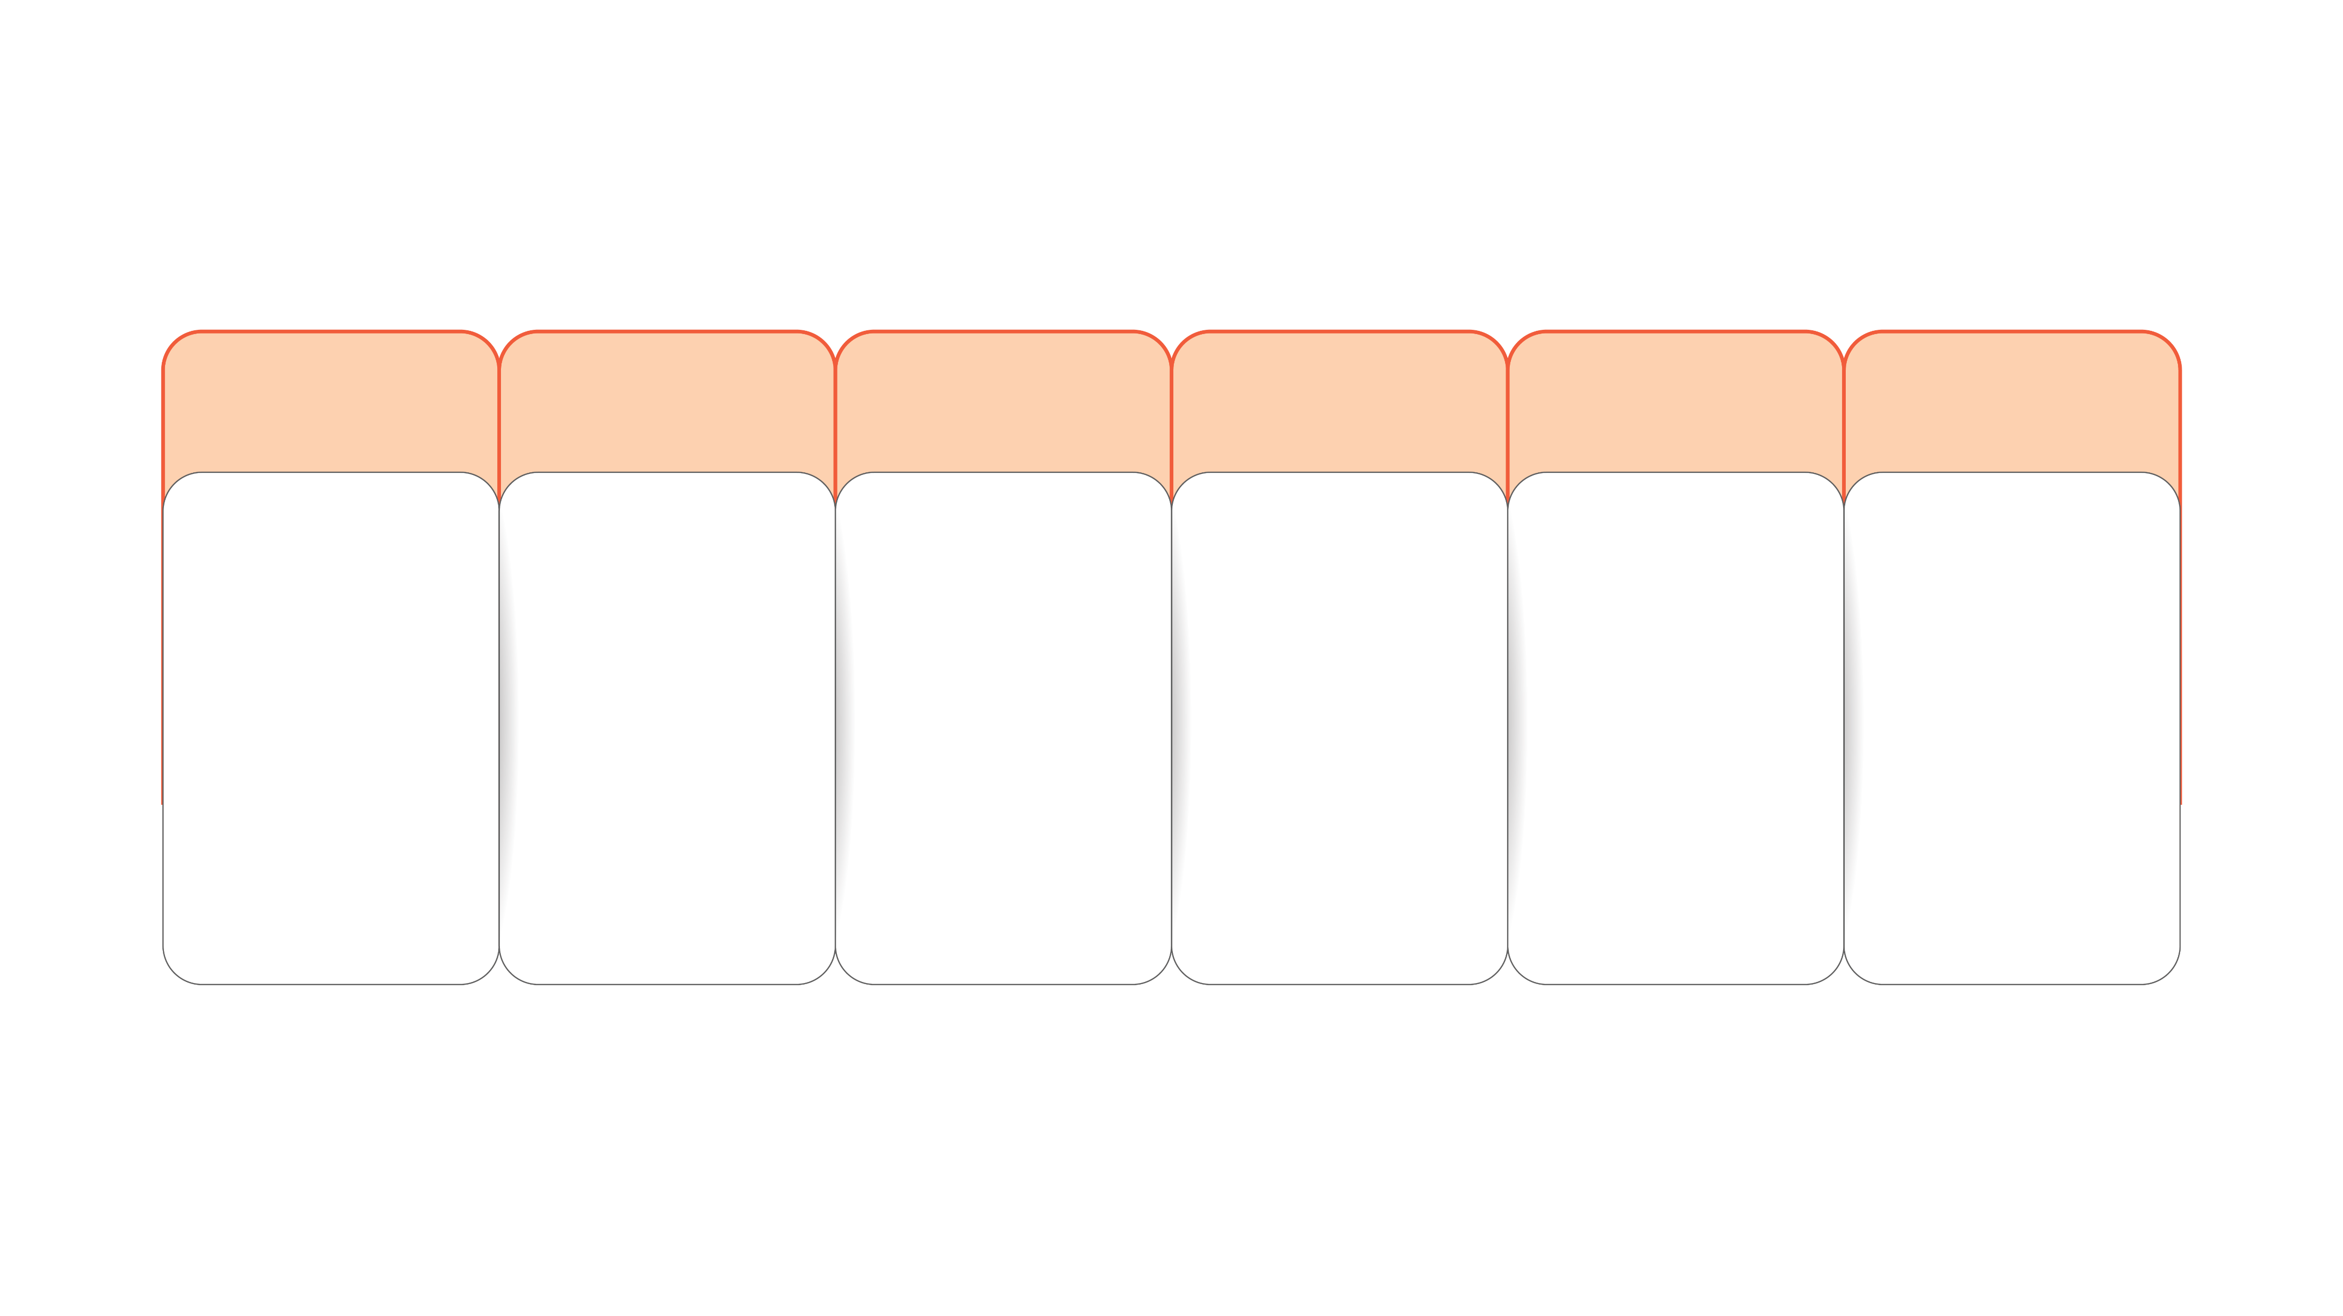






SDL: An Introduction
Issuers
Interest and Principal Payment
    Statutory Support
  Yields
    Credit Quality
    Risk Mitigation
State Governments
  Like G-Secs, at half yearly intervals. Paid by the RBI from a state’s allocation of central government funds
  Eligible for SLR
  Eligible for collateral under RBI’s Liquidity Adjustment Facility (LAF)
  Provide attractive yields vis-à-vis G-Secs for buy and hold investors
  Sovereign/Government bond.
  Assigned Zero Risk weight for Commercial Banks on account of Sovereign status
  Holding securities till maturity could be a strategy through which one could avoid market risk
Source: RBI, Internal Research.
09

Slide 10

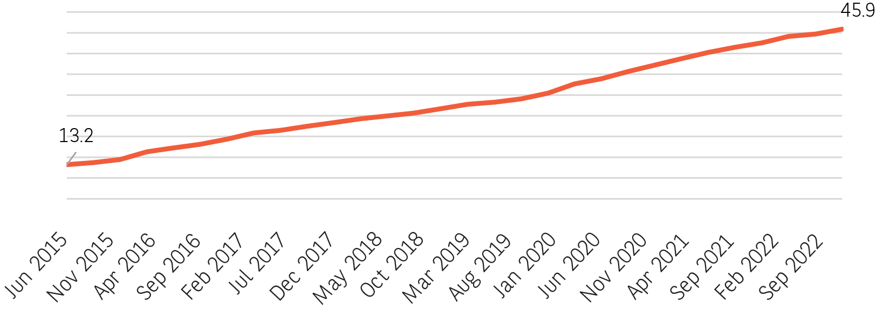




Ample Issuances & Diversified Investor Base
Holding Pattern of Outstanding SDLs – Share (%)
Total SDL Outstanding – (Rs Lac Crores)
Source: RBI. Data as on September 2022.
Source: RBI. Data as on September 2022.
Market Share of Platform
Investor base is well diversified among domestic institutions
Period | Total SDL Trading
Outstanding SDL issuances have increased over the years as States approach the capital markets for their borrowings
 | No. of Trades | Face Value (INR Crore)
 | 3,601 | 40,660
Nov-22
The Secondary market has been witnessing good trading activity and most of it is need based liquidity
Source: CCIL India. Data as on December 2022.
10

Slide 11

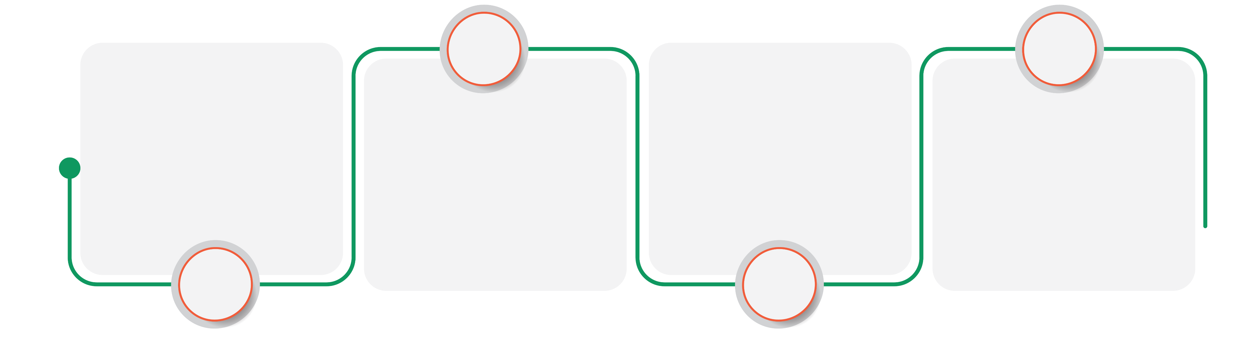




Improving Fiscal Health of States
Improved GST compensation to States leading to higher revenues and better fiscal health and consequently lower market borrowings
This, in turn, has led to lower borrowing by states. The share of states in total central-state govt borrowing has declined
Fiscal deficit for States likely to be below 3.5% in FY 23 from 4.7% in FY 21
Better fiscal health and relatively lower fresh issuances supports the spreads v/s G-Sec
Source: RBI and Internal Research. Data as on December 2022.
*Actual borrowing for Q4 FY 23 is assumed to be same as the budgeted i.e Rs. 3.40 lac crores
11

Slide 12

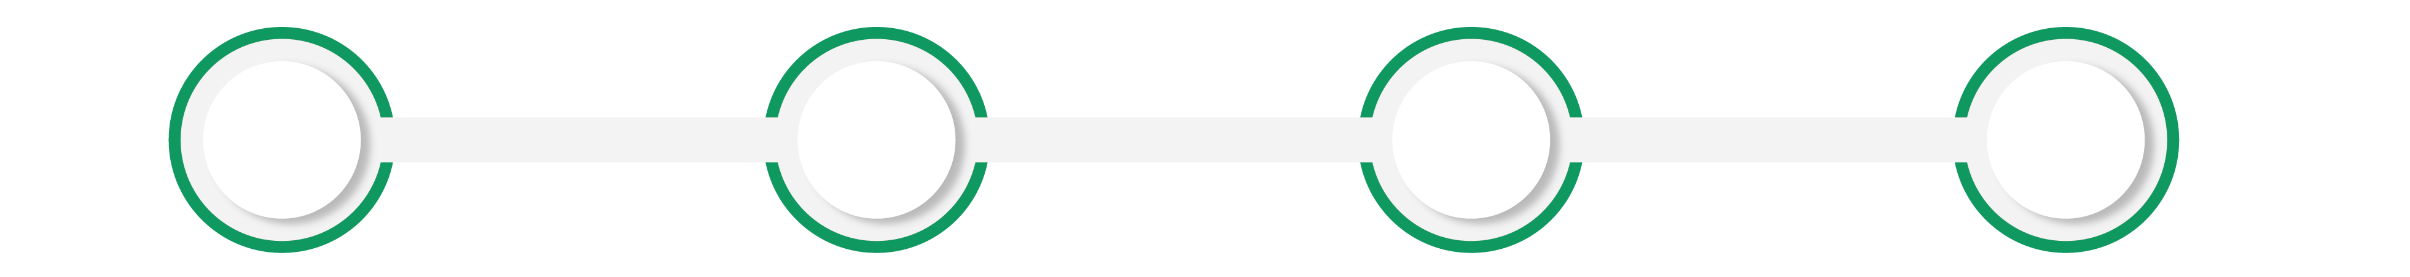




SDL yield near highest levels in last 3 years - A good time to invest at elevated yields
5 year SDLs and Repo Rates
CPI Inflation Growth (%)
RBI begins rate hikes
Current 3-5 year SDL yields are at highest level in last three years
As inflation appears past the peak, G-Sec and SDL yields have stabilized.
We believe the current yields discount any further policy rate hikes. Since June-22, Repo rate has been hiked by 190 bps, but SDL yields have remained steady.
In addition to attractive coupon, investors can potentially gain from bond price appreciation as well, in case rates were to fall in late 2023/early 2024
Source: RBI, Internal Research. Data as on December 2022. Past performance may or may not be sustained in the future.
12

Slide 13





Why 2026 SDL?
31/12/2021 | 30/12/2022 | Change | Spread over Repo
Repo rate
1-year T bill
3-year SDL
10-year SDL
4.00% | 6.25% | 2.25% | -
4.21% | 6.87% | 2.66% | 0.62%
5.49% | 7.33% | 1.84% | 1.08%
6.99% | 7.59% | 0.60% | 1.34%
Short-end of the curve 1-5 year was worst affected by the rate hikes during the year, hence presents most attractive opportunity to invest
3- 4 year segment offers yields similar to 10-year segment, with significantly less volatility
3- 4 year segment also aligns well from tax-efficiency perspective. Investments till March 31, 2023 and held beyond April 01, 2026 will qualify for 4 indexations
Source: Bloomberg
Past performance may or may not be sustained in the future.
13

Slide 14




Indexation Benefits
Comparison between Traditional Investment, Tax Free Bonds and Target Maturity Fund
Traditional investment | Target Maturity Fund | Tax Free Bond
Investment Amount
Rate of return (%)
Holding period (in years)
Indexation (%)
Value on Maturity
Indexed Cost
Taxable Amount
Applicable tax value*
Applicable tax amount
Post Tax Value
Net post tax return
100,000
7.37%
3.9
NA
132,282
100,000
32,282
30%
9,685
122,597
5.31%
100,000
7.37%
3.9
5%
132,282
121,551
10,731
20%
2,146
130,136
6.92%
100,000
5.10%
3.9
NA
121,616
100,000
NA
NA
NA
121,616
5.10%
Source: NSE indices *Traditional Investment taxed at 30% and Target Maturity Fund taxed at 20% post indexation exclusive of applicable surcharges & cess. Rate of return for traditional investment is assumed to be same as the yield of the Benchmark Index. Rate of return for Target Maturity Fund is the yield of the index as on December 30, 2022, and does not include scheme expenses, impact cost, etc. (Source: NSE Index methodology document). Rate of indexation is assumed to be 5%. Rate of tax-free bonds is the average yield of tax-free bonds traded on NSE. Investors are advised to consult their tax advisors for taxation related matters. To be used for illustrative purposes only illustration to explain the concept of indexations and its benefits and actual dates and figures would vary. Actual tax implications may differ basis prevailing tax laws. The Scheme is not providing any assured or guaranteed returns, neither forecasting any returns. This is not an indicative yield as well of the product. Traditional Saving Schemes such as Fixed Deposits and Target Maturity Funds are not comparable. The comparison is limited to tax efficiency, which is subject to changes in prevailing tax laws. Investments in FDs are insured by Deposit Insurance and Credit Guarantee Corporation (DICGC) upto a maximum of Rs. 1,00,000 (Rupees one lakh) for both principal and interest amount.
Past Performance may or may not be sustained in future.
14

Slide 15
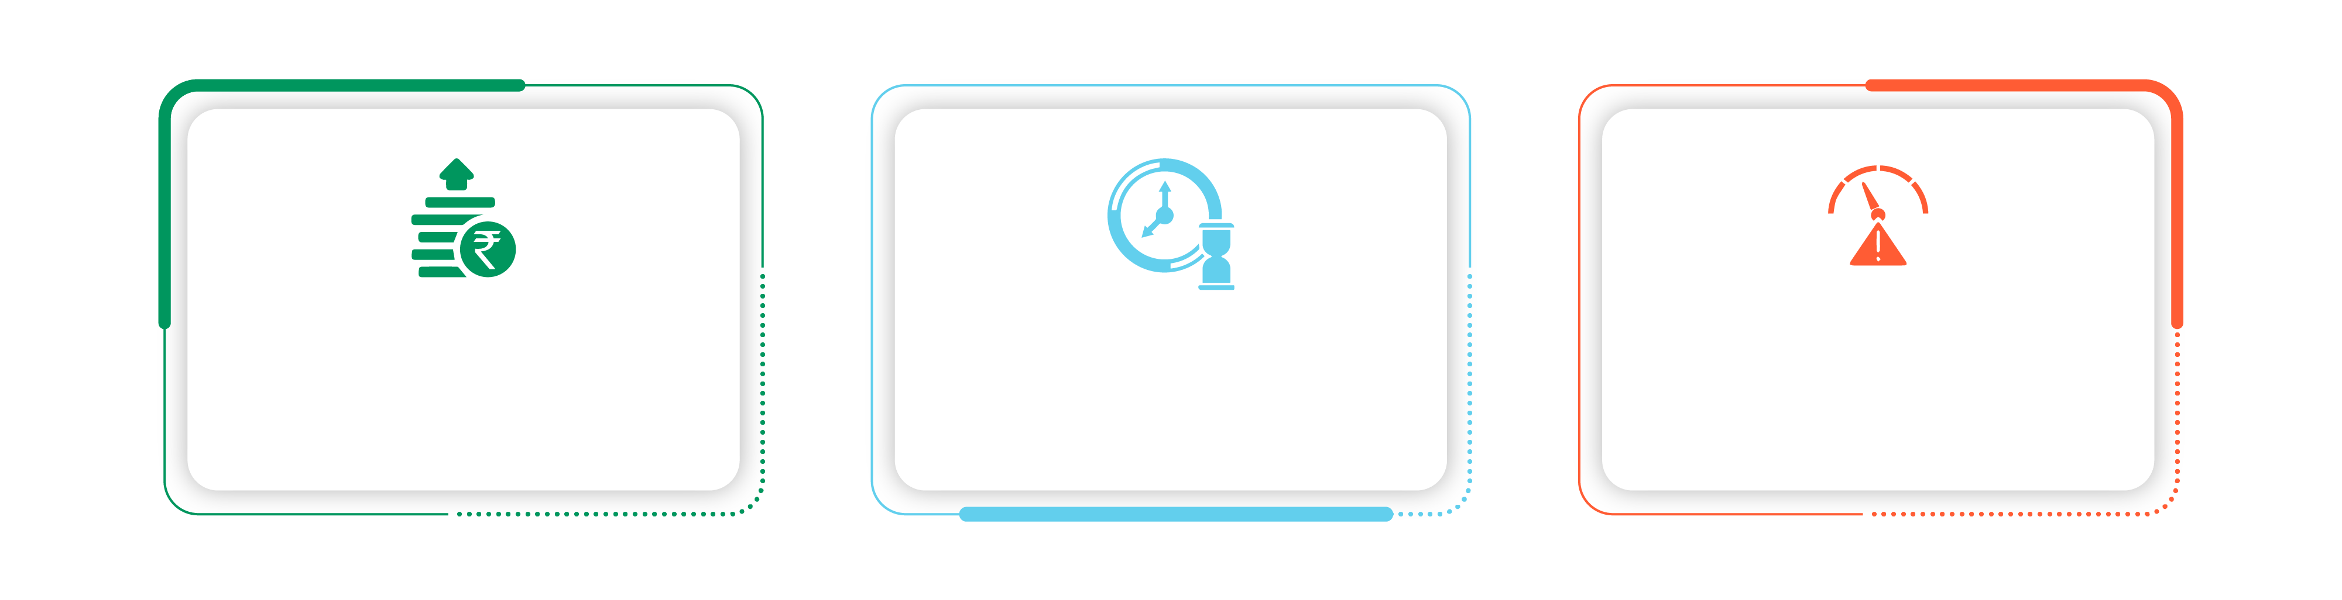
Who is it suitable for?
Investors looking for predictable income*
Investors whose investment horizon matches with the maturity date of the fund
Investors with moderate risk appetite
*When held till maturity
Past performance, including such scenarios, is not an indication of future performance.
15

Slide 16
Fund Facts
Scheme Name | Baroda BNP Paribas Nifty SDL December 2026 Index Fund
Type of the Scheme: | An open-ended Target Maturity Index Fund replicating / tracking the NIFTY SDL December 2026 Index. A relatively Moderate Interest Rate Risk and Relatively Low Credit Risk.
NFO Period | January 16, 2023, to January 23, 2023
Investment Objective: | The investment objective of the scheme is to provide investment returns closely corresponding to the total returns of the securities as represented by the Nifty SDL December 2026 Index before expenses, subject to tracking errors, fees and expenses. However, there can be no assurance that the investment objectives of the Scheme will be realized. The Scheme does not guarantee/indicate any returns.
Underlying Index: | NIFTY SDL December 2026 Index
Fund Manager: | Mayank Prakash (Total Experience: 14 years)
Asset Allocation: | During normal circumstances, the Scheme’s exposure to money market instruments will be in line with the asset allocation table. However, in case of maturity of instruments in the Scheme portfolio, the reinvestment will be in line with the index methodology. The cumulative gross exposure to instruments forming part of the Index, debt and money market instruments, units of liquid and debt mutual fund schemes and such other securities/assets as may be permitted by SEBI from time to time subject to approval will not exceed 100% of the net assets of the scheme. The Scheme will not invest in equity and equity related securities and Foreign Securities. The Scheme will not indulge in short selling and securities lending and borrowing. For complete details on asset allocation, please refer to SID available on our website (www.barodabnpparibasmf.in)
Load Structure: | Entry Load: Nil. Exit Load: Nil.
Options: | The scheme will have two Plans: Regular and Direct. Each Plan offers Growth Option and Income Distribution cum Capital Withdrawal (IDCW) Option*. The IDCW option offers payout of Income Distribution cum Capital withdrawal option. *Amounts under IDCW option can be distributed out of investors capital (equalization reserve), which is part of sale price that represents realised gains. However, investors are requested to note that the amount of distribution under IDCW Option is not guaranteed and subject to availability of distributable surplus.
Minimum Application Amount: | Lumpsum investment: Rs. 5,000 and in multiples of Re. 1 thereafter. SIP: (i) Daily, Weekly, Monthly SIP: Rs. 500/- and in multiples of Re. 1/- thereafter; (ii) Quarterly SIP: Rs. 1500/- and in multiples of Re. 1/- thereafter.
Type of Instrument | Minimum (% of Net Assets) | Maximum (% of Net Assets) | Risk Profile
Debt Instruments comprising of Nifty SDL December 2026 Index | 95 | 100 | High
Money Market instruments | 0 | 5 | Low to Medium
16

Slide 17
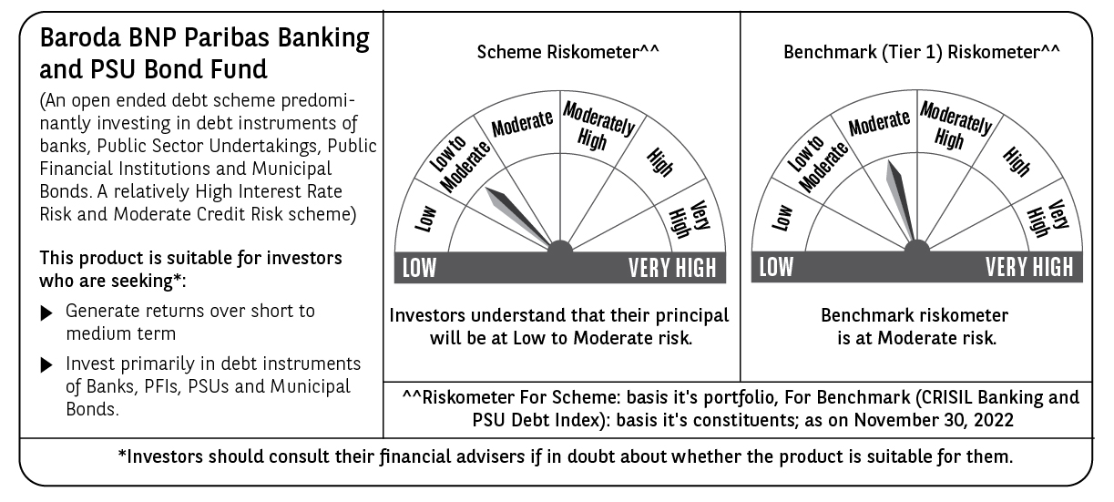
Risk Factors
Trading volumes and settlement periods may restrict liquidity in debt investments. Investment in Debt is subject to price, credit, and interest rate risk. The NAV of the Scheme may be affected, inter alia, by changes in the market conditions, interest rates, trading volumes, settlement periods and transfer procedures. The NAV may also be subjected to risk associated with tracking error. Past performance may or may not be sustained in future.
Please refer to Scheme Information Document available on our website (www.barodabnpparibasmf.in) for detailed Risk Factors, assets allocation, investment strategy etc.
This product is suitable for investors who are seeking*: | Riskometer for the Scheme^^ | Benchmark (Tier 1) Riskometer^^
Income for the target maturity period. An open ended target maturity fund seeking to track the Nifty SDL December 2026 Index. | Investors understand that their principal will be at Moderate Risk. | Benchmark (NIFTY SDL December 2026 Index) riskometer at Moderate Risk
*Investors should consult their financial advisers if in doubt about whether the product is suitable for them. ^^the riskometer assigned is based on internal assessment of the scheme characteristics and the same may vary post NFO when actual investments are made.
17

Slide 18
Potential Risk Class (PRC) Matrix
Potential Risk Class (PRC) Matrix*
 | Baroda BNP Paribas Nifty SDL December 2026 Index Fund
Credit Risk (Max) | Relatively Low: Class A (CRV >= 12) | Moderate: Class B (CRV >= 10) | Relatively High: Class C (CRV <10)
Interest Rate Risk (Max)
Relatively low Class I (MD<=1 year)
Moderate Class II (MD<=3 year)
Relatively High Class III (Any MD) | A-III
MD=Macaulay Duration, CRV=Credit Risk Value
*The PRC matrix denotes the maximum risk that the respective Scheme can take i.e., maximum interest rate risk (measured by MD of the Scheme) and maximum credit risk (measured by CRV of the Scheme)
18

Slide 19
Disclaimers
Disclaimers: The material contained herein has been obtained from publicly available information, internally developed data and other sources believed to be reliable, but Baroda BNP Paribas Asset Management India Private Limited ( formerly BNP Paribas Asset Management India Private Limited) (AMC) makes no representation that it is accurate or complete. The AMC has no obligation to tell the recipient when opinions or information given herein change. It has been prepared without regard to the individual financial circumstances and objectives of persons who receive it. This information is meant for general reading purpose only and is not meant to serve as a professional guide for the readers. Except for the historical information contained herein, statements in this publication, which contain words or phrases such as 'will', 'would', etc., and similar expressions or variations of such expressions may constitute 'forward-looking statements'. These forward looking statements involve a number of risks, uncertainties and other factors that could cause actual results to differ materially from those suggested by the forward-looking statements. The AMC undertakes no obligation to update forward-looking statements to reflect events or circumstances after the date thereof. The words like believe/belief are independent perception of the Fund Manager and do not construe as opinion or advise. This information is not intended to be an offer to sell or a solicitation for the purchase or sale of any financial product or instrument. The information should not be construed as an investment advice and investors are requested to consult their investment advisor and arrive at an informed investment decision before making any investments. The sector(s) mentioned in this document do not constitute any recommendation of the same and Baroda BNP Paribas Mutual Fund may or may not have any future position in these sector(s). The Trustee, AMC, Mutual Fund, their directors, officers or their employees shall not be liable in any way for any direct, indirect, special, incidental, consequential, punitive or exemplary damages arising out of the information contained in this document.
MUTUAL FUND INVESTMENTS ARE SUBJECT TO MARKET RISKS, READ ALL SCHEME RELATED DOCUMENTS CAREFULLY.
NSE INDICES LIMITED DISCLAIMERS:
“The “Product” offered by “the issuer” is not sponsored, endorsed, sold or promoted by NSE INDICES LIMITED (formerly known as India Index Services & Products Limited (IISL)). NSE INDICES LIMITED does not make any representation or warranty, express or implied (including warranties of merchantability or fitness for particular purpose or use) and disclaims all liability to the owners of “the Product” or any member of the public regarding the advisability of investing in securities generally or in the “the Product” linked to NIFTY SDL December 2026 Index or particularly in the ability of the NIFTY SDL December 2026 Index to track general market performance in India. Please read the full Disclaimers in relation to the NIFTY SDL December 2026 Index in the in the Offer Document / Prospectus / Information Statement.”
19

Slide 20
THANK YOU

